Slide 1
Tachyon: Reliable, Memory Speed Storage for Cluster Computing
罗艺康118037910036
Notes:
1.血统连过长会带来什么？
2.Edge algorithm leaves 和 high Priority 哪个更优先？ High Priority.
3.资源到底以什么方式分配。
4. when too small an intervalpicked, checkpointing cannot keep up with program progressand starts lagging behind

Slide 2
Outlines
1
Background
2
Design
3
Evaluation

Slide 3
Contents
1
Background
2
Design
3
Evaluation

Slide 4
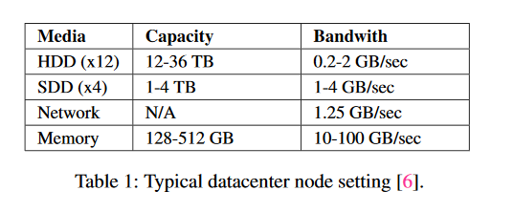
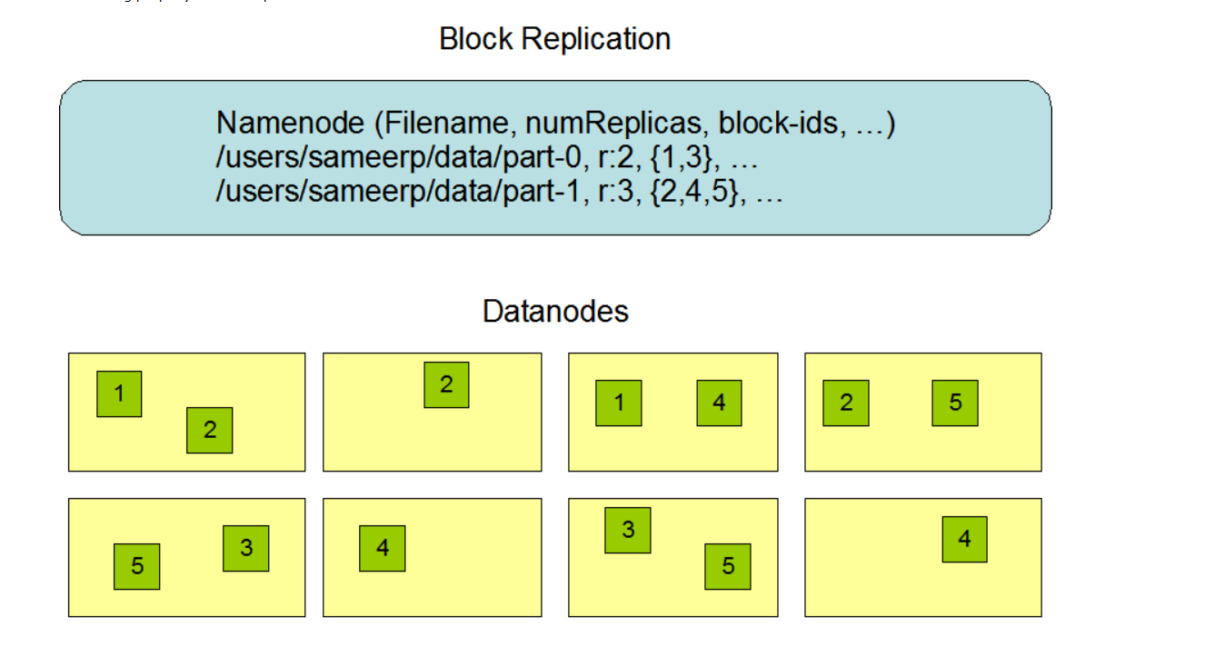
1.Background
slow writing data(fault-tolerance)
HDFS (replication-based file system)
Solution: shared memory (no replication)

Slide 5
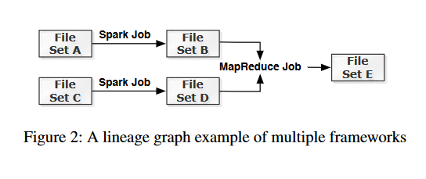
1.Background
Lineage Information(checkpoint and recomputation)

Slide 6
1.Background
Two challenges
1.Timing of checkpoint(Cost on checkpointing vs Cost on recmputation)
2.Recomputation(not influence other high priority jobs)

Slide 7
Contents
1
Background
2
Design
3
Evaluation

Slide 8
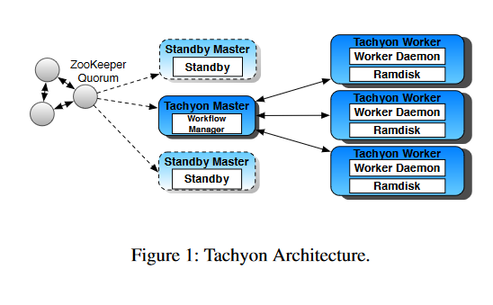
2.Design
Tachyon(lineage and
persistence layer)
Workflow manager
(checkpoint, resource allocation)
Master Fault-Tolerance(log operations)

Slide 9
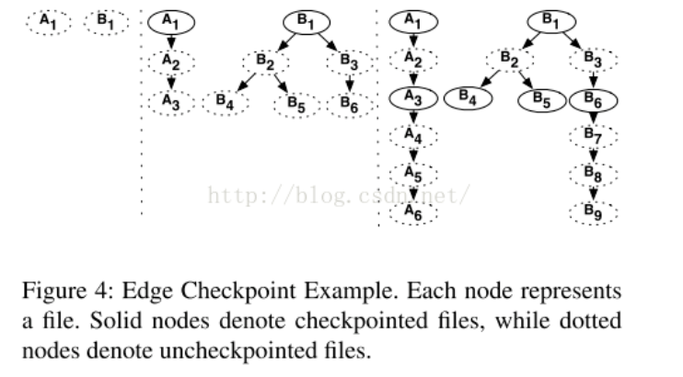
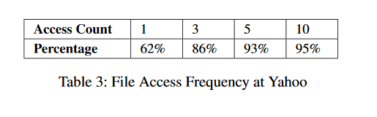
2.Design
Edge algorithm
(target for 1st challenge)
Checkpointing Leaves(job finishes)
Checkpointing Hot Files
(access count > 2)
Avoid checkpointing temporary files
Dealing with Large Data Sets
(memory first, burst situations to avoid the evictions of uncheckpointed files)

Slide 10
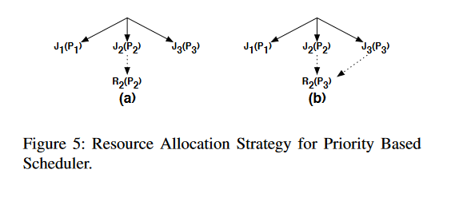
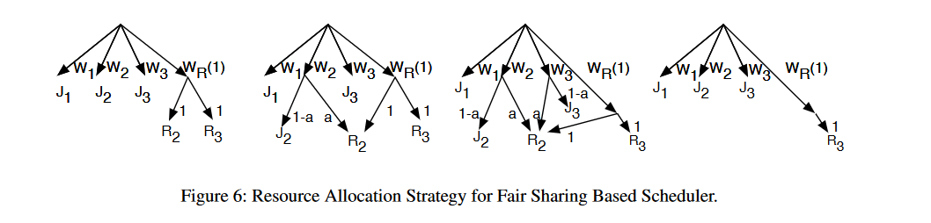
2.Design
Resource Allocation
(target for 2nd.challenge)
Priority Based Scheduler
Fair Sharing Based Scheduler
Recomputation Order(DAG, file dependcy)
Notes:
J2 need R2 to prepare file
a is the weight for the job share the resources for r2.

Slide 11
Contents
1
Background
2
Design
3
Evaluation

Slide 12
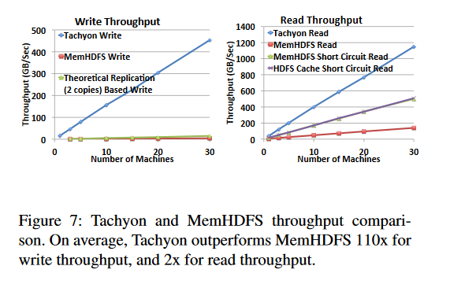
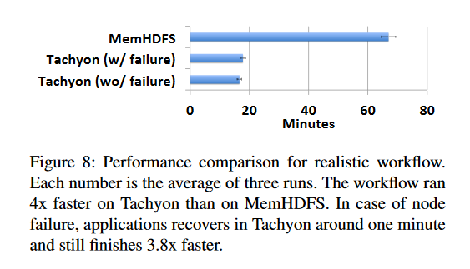
3.Evaluation
Raw Performance(1GB data)
Realistic task(video analytics )

Slide 13
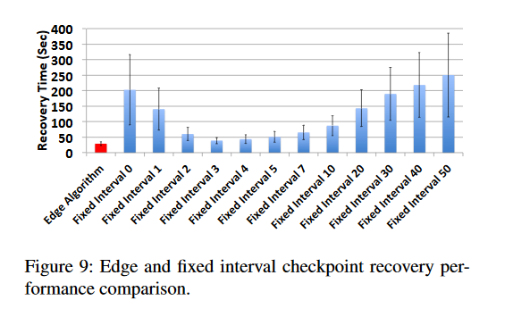
3.Evaluation
Edge Checkpointing Algorithm
Small interval -> checkpointing cannot keep up
Large interval -> long recomputation

Slide 14
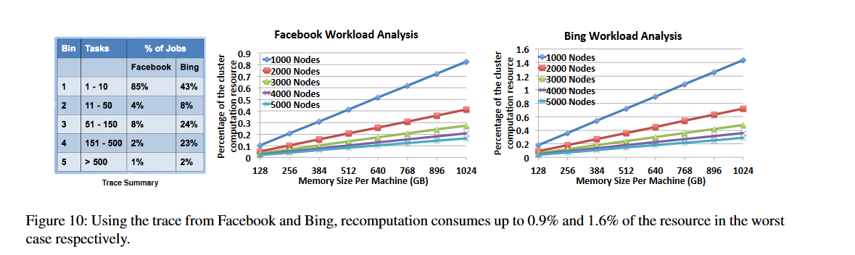
3.Evaluation
Recomputation Resource Consumption

Slide 15

谢谢！

